Slide 1
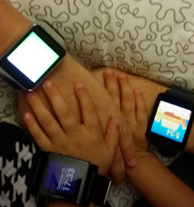
Free Mobile Device Apps for Data Collection and Analysis
Rebecca Vieyra
AAPT Winter Meeting 2015

Slide 2
Cary-Grove High School
Albert Einstein Fellow
NASA Aeronautics, DC

Slide 3
Why Mobile Apps?
Individual lab equipment
Take-home labs
Field trip labs
Free
Creative homework
Real, “messy” data

Slide 4
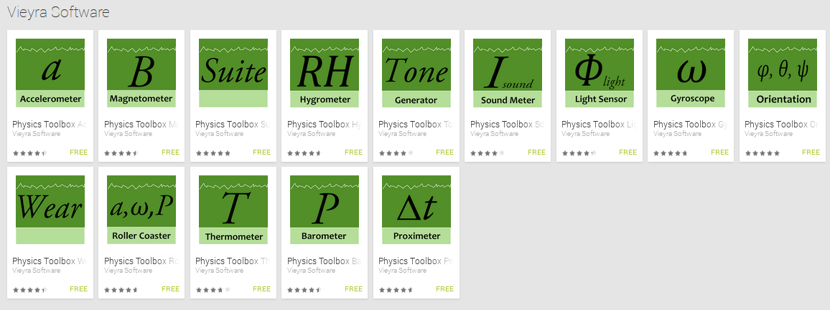
Physics Toolbox Apps - Vieyra Software
All apps are free
no cost
no in-app purchases
no advertisements
Featured in Google Play for Education

Slide 5
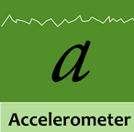
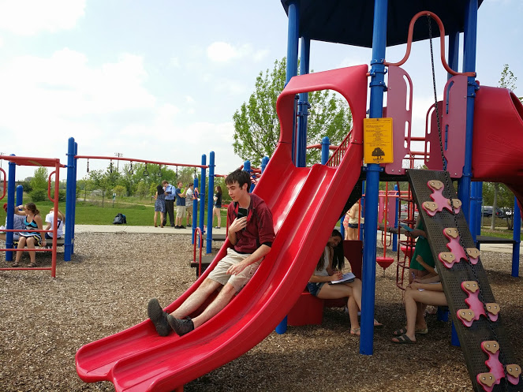
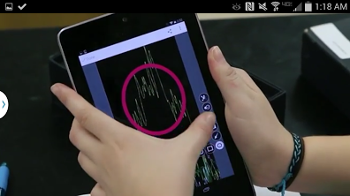
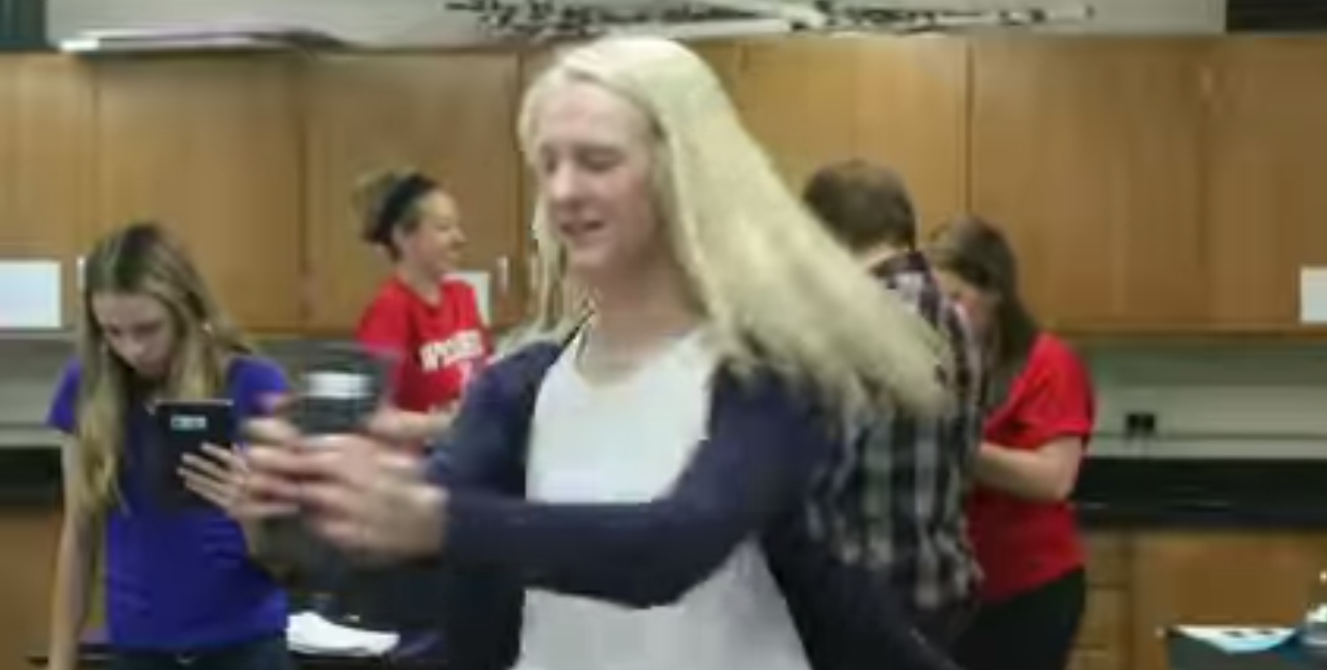
What can your mobile device do?

Slide 6
What is the plane doing?

Slide 7
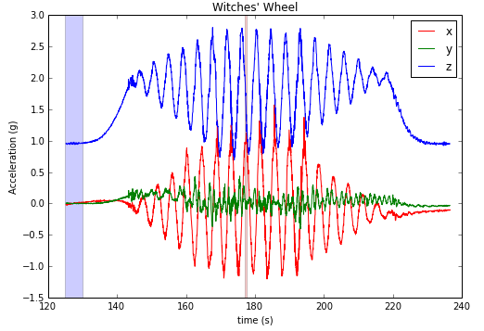
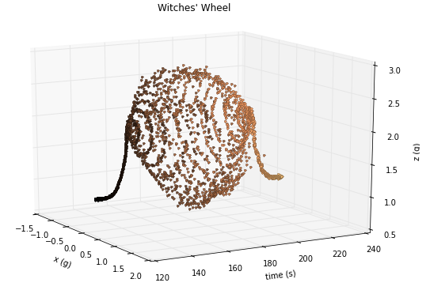
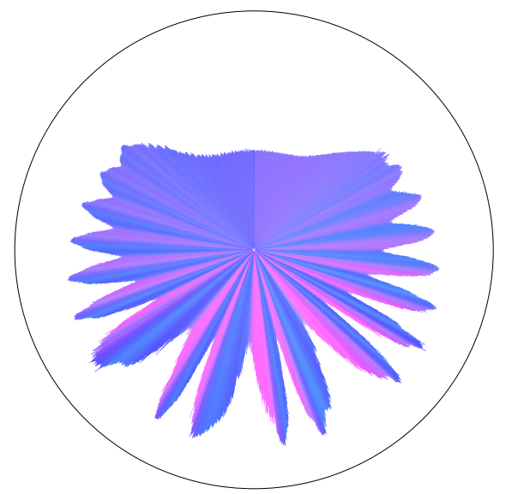
http://blog.robindeits.com/2013/11/11/roller-coaster-visualizations/

Slide 8
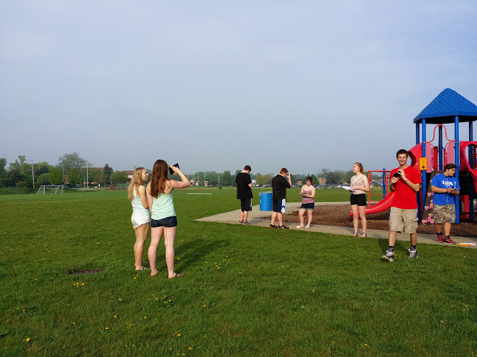

Slide 9
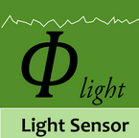
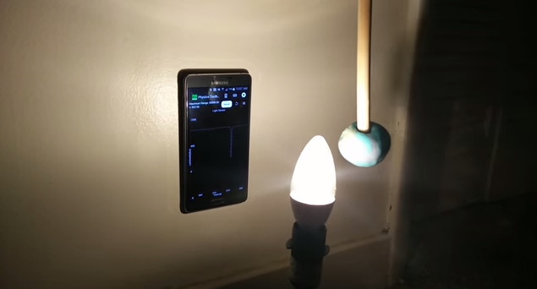

Slide 10
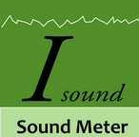
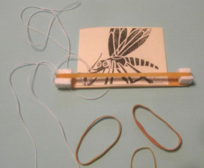
http://goo.gl/GtBlte
http://goo.gl/GtBlte

Slide 11
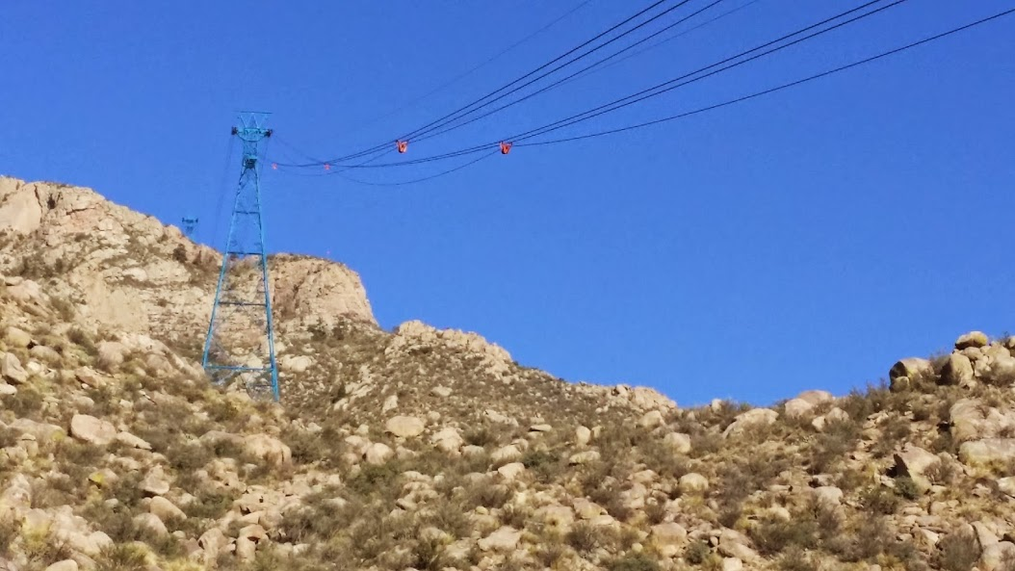

Slide 12
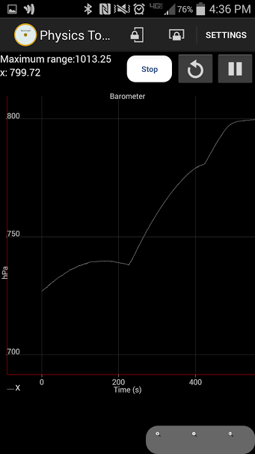
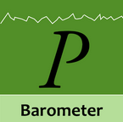
Going up or down?
What are the dips in the data?

Slide 14
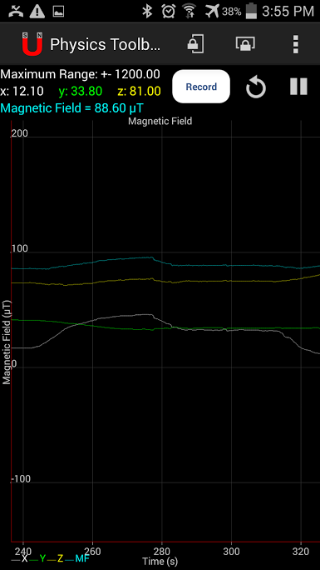
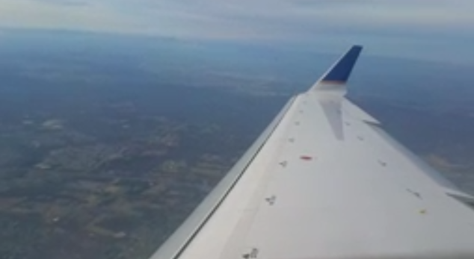
What is the plane doing?

Slide 15
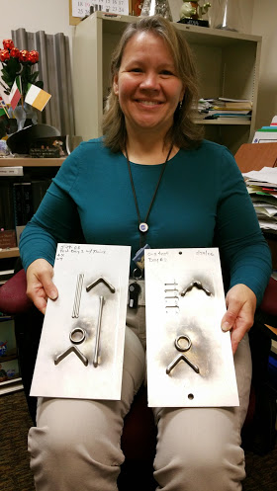
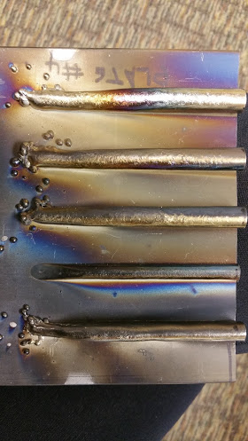
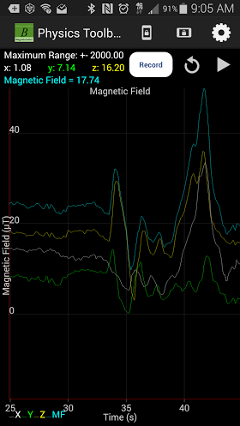

Slide 16
Sensors and outputs...
+ = Beats
Camera Flash = Stroboscope

Slide 17
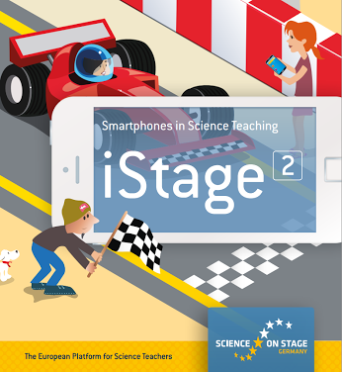
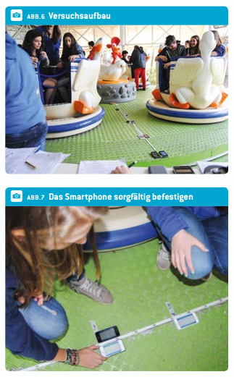

Slide 18
Please share your ideas with me! Thank you!
Gmail: vieyrasoft@gmail.com
Twitter: @RVieyraAEF
G+ Community: Mobile Sensor Apps for Learning
Site: RVieyraAEF
Google Play: Vieyra Software

